Slide 1
Cluster Analysis
Hierarchical Clustering

Slide 2






What is Hierarchical Clustering
This is an agglomerative clustering technique (i.e. bottom-up in nature)
All the data points, in the beginning, are considered as individual clusters
The final cluster comprises of all the data points
Data points are clustered based on similarity/dissimilarity measures
Usually, Euclidean and cosine distance measures are considered for creating dissimilarity matrix
Combining clusters depend on linkage function

Slide 3
Linkage Functions
There are several linkage functions available for hierarchical clustering
We will focus on these four commonly used methods
Single linkage
Complete linkage
Group linkage
Ward method

Slide 4
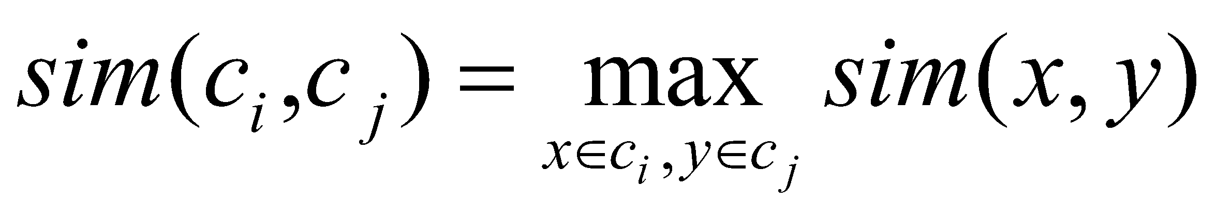
Single Link Agglomerative Clustering
Use maximum similarity of pairs:
Can result in “straggly” (long and thin) clusters due to chaining effect.
After merging c_{i} and c_{j}, the similarity of the resulting cluster to another cluster, c_{k}, is:

Slide 5
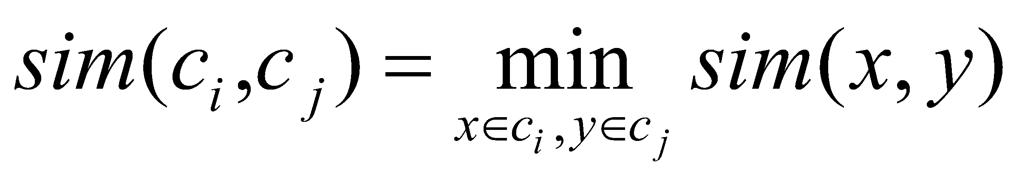
Complete Link Agglomerative Clustering
Use minimum similarity of pairs:
Makes “tighter,” spherical clusters that are typically preferable.
After merging c_{i} and c_{j}, the similarity of the resulting cluster to another cluster, c_{k}, is:
C_{i}
C_{j}
C_{k}

Slide 6
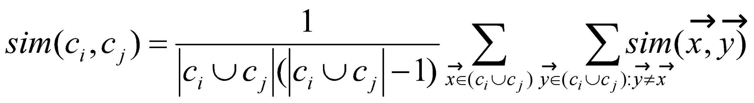
Group Average Agglomerative Clustering
Use average similarity across all pairs within the merged cluster to measure the similarity of two clusters
Compromise between single and complete link
Two options:
Averaged across all ordered pairs in the merged cluster
Averaged over all pairs between the two original clusters
Some previous work has used one of these options; some the other. No clear difference in efficacy
Notes:
Weighted average can be computed efficiently (remember avg and number of points)

Slide 7
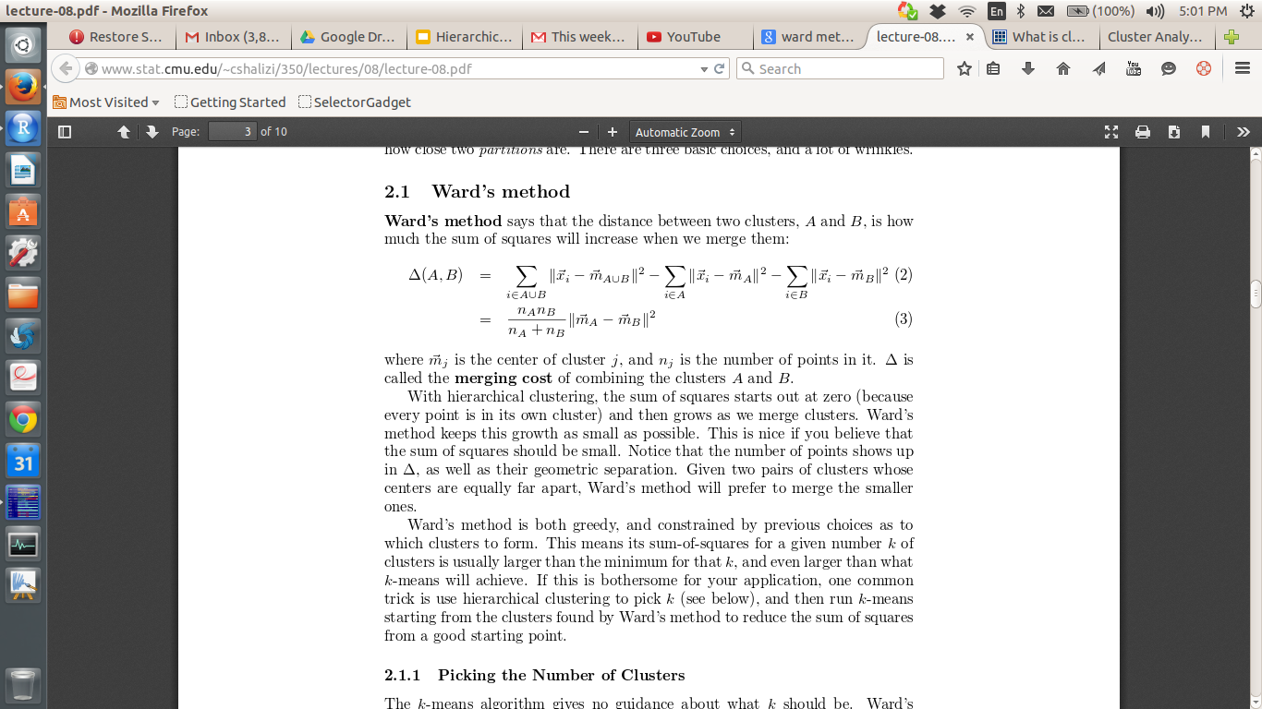
Ward Method
It says that distance between any two clusters A and B is the increase in
sum of square of the merged clusters when compared to individual sum of squares of A and B together
This method tries to club clusters to minimize the increase in sum of square value
Mathematically,
Ward’s method is greedy and is applicable for quantitative data only

Slide 8
Example
Consider A, B, C, D, E as cases with the following similarities:
A B C D E
A - 2 7 9 4
B 2 - 9 11 14
C 7 9 - 4 8
D 9 11 4 - 2
E 4 14 8 2 -
Highest pair is: E-B = 14

Slide 9
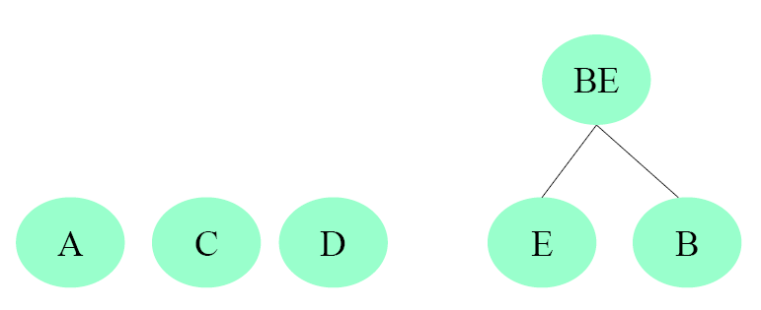
Example
So lets cluster E and B. We now have the structure:

Slide 10
Example
Now we update the case-to-case matrix.
A BE C D
A - 2 7 9
BE 2 - 8 2
C 7 8 - 4
D 9 2 4 -
Note: To compute BE -- SC (A, B) = 2
SC (A, E) = 4
SC(A,BE) = 4 if we are using single link (take max)
SC(A,BE) = 2 if we are using complete linkage (take min)
SC(A,BE) = 3 if we are using group average (take average)
Note: C - BE is now the highest link

Slide 11
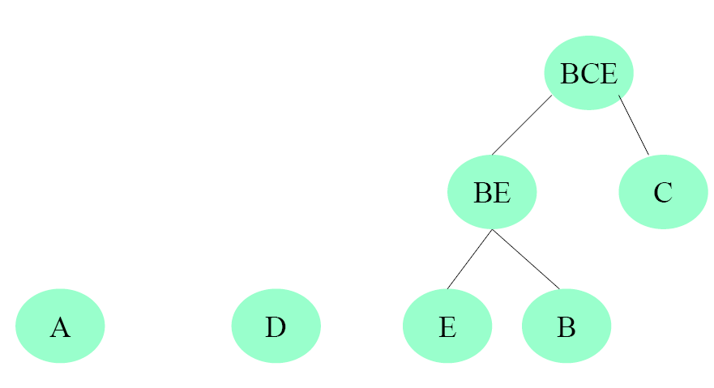
Example so lets cluster BE and C.we now have the structure:

Slide 12
Example
Now we update the case-to-case matrix.
A BCE D
A - 2 9
BCE 2 - 2
D 9 2 -
To compute SC(A, BCE):
SC (A, BE) = 2
SC (A, C) = 7 so SC(A,BCE) = 2
To Compute: SC(D,BCE)
SC(D, BE) = 2
SC(D, C) = 4 so SC(D, BCE) = 2
SC(D,A) = 9 which is greater than SC(A,BCE) or SC(D,BCE)
so we now cluster A and D.

Slide 13
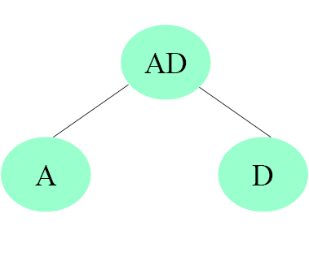
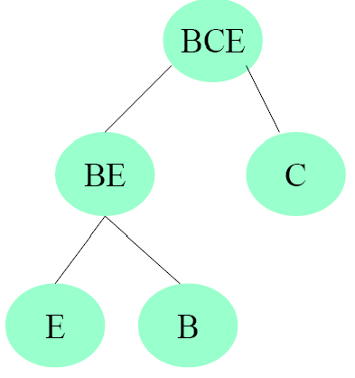
Example
So lets cluster A and D. At this point, there are only two nodes that have not been clustered, AD and BCE. We now cluster them.

Slide 14
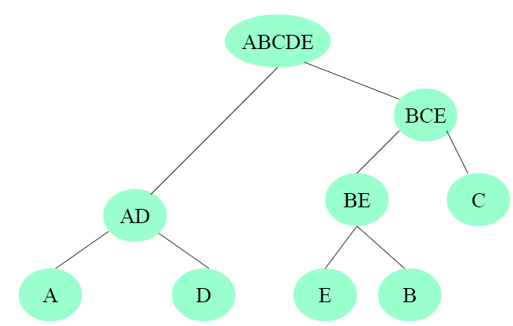
Example
Now we have clustered everything

Slide 15
A few more points
To extract proper clusters, careful observation is required while analyzing dendogram
Clusters are formed and get clubbed with other clusters at different heights
Choice of height in cutting the tree (to extract cluster membership), thus requires careful observation
Usually some measures are also extracted while clusters are being formed (such as Cubic Clustering Criteria or CCC) which can help in deciding optimum number of clusters in hierarchical clustering

Slide 16
R codes
Let us use the same dataset what we saw in density based clustering
The dataset can be found here also
Hierarchical clustering needs to have dissimilarity matrix as its parameter and a distance matrix can act as a dissimilarity matrix
The following code will do hierarchical clustering of data points (using all default parameters)
dist=dist(data)
hc=hclust(dist)
plot(hc)

Slide 17
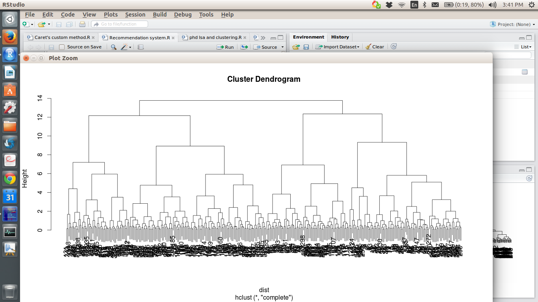
Dendogram

Slide 18
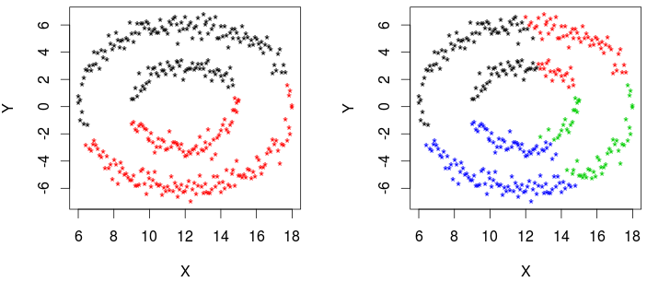
Data Plot
Clustering of data points with 2 cluster and 4 cluster solution
“Complete Linkage” could not bring out the proper clusters
dist=dist(data)
hc=hclust(dist,method="complete")
c2=cutree(hc,k=2)
c4=cutree(hc,k=4)
layout(matrix(c(1,2),ncol=2))
plot(data,col=c2,pch="*")
plot(data,col=c4,pch="*")

Slide 19
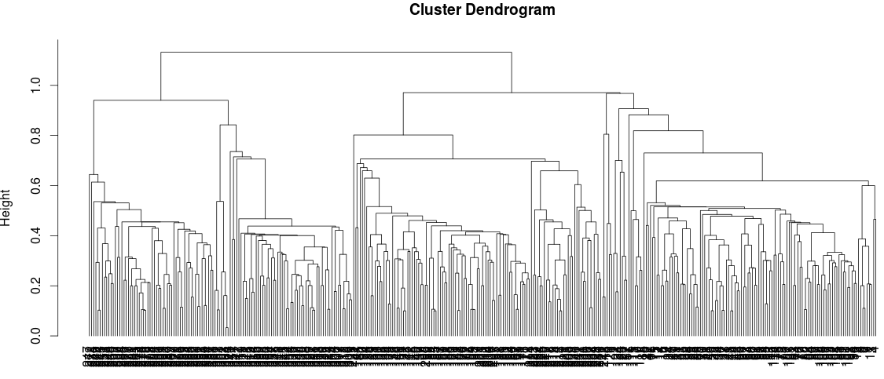
Dendogram (Single Linkage)
Single Linkage method produces chain like structures and hence the dendogram also looks complicated
However, this method has produced the correct cluster

Slide 20
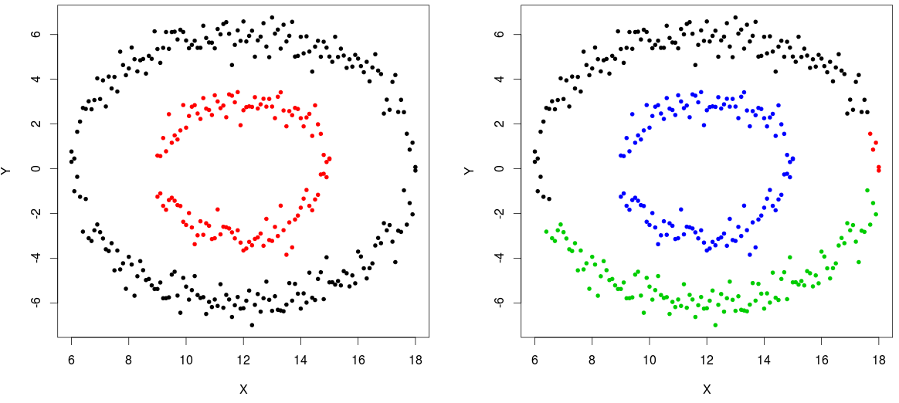
Clustering with Single Linkage
dist=dist(data)
hcSL=hclust(dist,method="single")
k2=cutree(hcSL,k=2)
k4=cutree(hcSL,k=4)
layout(matrix(c(1,2),ncol=2))
plot(data,col=k2,pch=20)
plot(data,col=k4,pch=20)
# of cluster is 2
# of cluster is 4

Slide 21
Advantages and Disadvantages
Advantages of hierarchical clustering are
Easy to understand
Often efficient in clustering
Disadvantages of hierarchical clustering are
Not very much scalable
Choice of distance measure is far from trivial job
Choice of algorithm is also not an easy task
Not applicable for dataset with missing values
Due to heuristic nature, greedy search may result in unclear cluster hierarchy

Slide 22
Hierarchical Clustering with p-value
Hierarchical clustering can also be associated with uncertainty (i.e. whether the cluster formed is actually a cluster or not)
Normal hierarchical clustering does not produce any such information about the clusters formed
Hence, multiple bootstrapping can be done to asses cluster uncertainty in hierarchical clustering
‘pvclust’ package in R does the same analysis to detect correct clusters

Slide 23
Hierarchical Clustering with p-value
Let us consider a small subset from dataset autompg (first 50 cases only)
Since bootstrapping is required to be done, sample size is kept low (for demo purpose only)
Moreover, only 5 numeric variables are taken into consideration
pvclust, by default, clusters the variables and hence, for clustering cases, transpose of the matrix should be supplied

Slide 24
R Code
autompg=read.csv(file.choose())
# Small subset selection
autompg1=na.omit(autompg)[1:50,c(3:6,9)]
library(pvclust)
library(snow) # for parallel computation
cl=makeCluster(10,”MPI”) # Creating 10 slaves for parallel computation
# Running pvclust with 1000 bootstrap sampling with different relative sample size
pvclust=parPvclust(cl,t(autompg1),”com”,”euc”,nboot=1000)
plot(pvclust)
pvrect(pvclust,alpha=0.95)

Slide 25
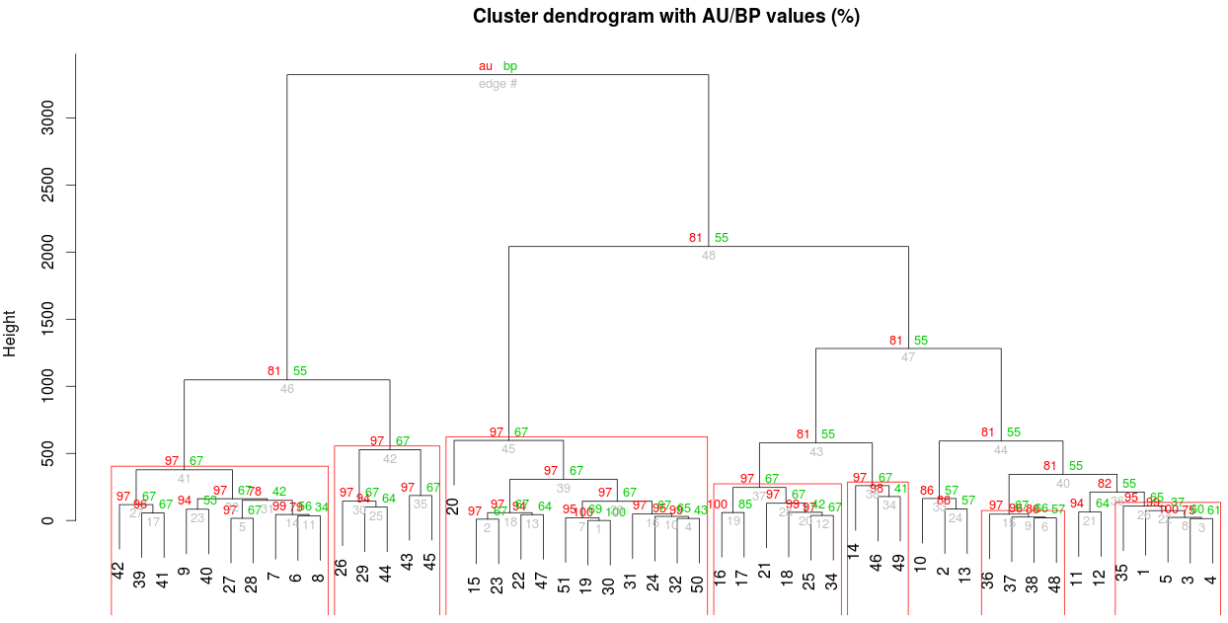
Dendogram with p-values
Rectangles are placed at 95% confidence level where the clusters are formed NOT BY CHANCE

Slide 26
Probabilistic Hierarchical Clustering
Probabilistic hierarchical clustering tries to overcome the problems of normal hierarchical clustering by using probabilistic models to measure distance between clusters
It assumes that data are being generated from generative models and each model essentially describe respective clusters
Usually Gaussian distribution of Bernoulli distribution are used in such situations and the objectives lies in estimating the parameters as accurately as possible to generate the same set of data (best fit)
In this sense, it resembles MLE of parameters using Expectation Maximization process
However, for hierarchical clustering, the distances are calculated differently

Slide 27
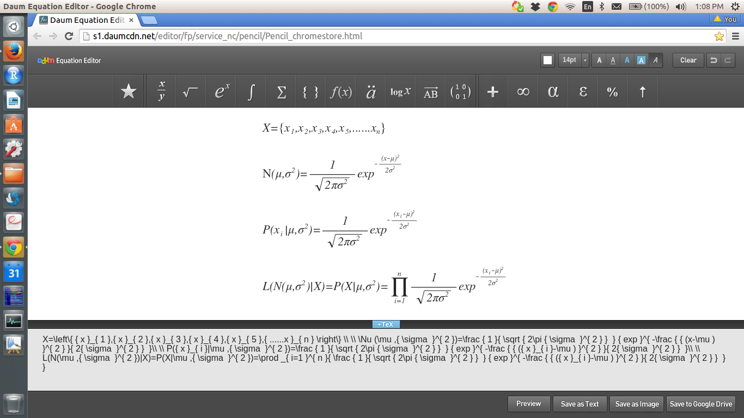
Probabilistic Hierarchical Clustering
Let us consider a 1-D dataset (for simplicity)
We can assume that this dataset is generated from a Gaussian distribution with parameters μ and σ
Probability that a point x is generated from this distribution is
Consequently, the likelihood function is

Slide 28
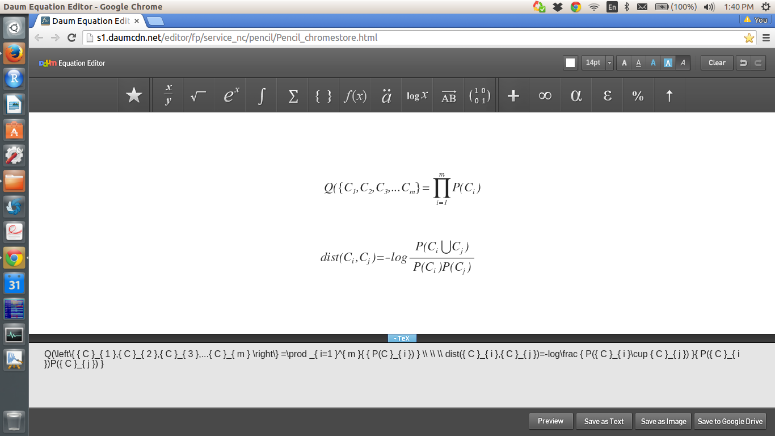
Probabilistic Hierarchical Clustering
If the given dataset is partitioned into m different clusters, quality of clustering can be measured by
where P() is the maximum likelihood
Distance between two clusters is given by
Two clusters keep on merging as long as > 0

Slide 29
Special case
Since, hierarchical clustering needs similarity/dissimilarity measures to cluster objects, hierarchical clustering can be used to cluster data points with mixed data type
However, a different similarity measure is computed using “gower” method
“Gower” similarity measure is not a strict numerical measure and hence, it should not be used in clustering algorithm which assumes data to be numeric in nature (e.g. k-means)

Slide 30
Gower similarity measure
This is a measure which is non metric in nature but can give similarity index between two data points which contain both categorical and numerical data
Gower distance is bound within [0,1]
Gower distance is calculated by taking average of distance measure between ith and jth row considering distances w.r.t. individual variable/attribute
for categorical attributes: 0 if equal, 1 otherwise
for ordered attributes: 0 if equal, proportional to rank distance otherwise
for continuous attributes: proportional to ratio of distance and range of the attribute

Slide 31
Hierarchical clustering with gower dist
In this analysis, we will use the autompg dataset
The first variable is useless and hence deleted
The 2nd, 7th and 8th variable are essentially categorical in nature and hence they are made categorical through type casting
Thus the new dataset becomes a dataset with mixed variables (along with missing data)
To use K-means clustering, we need to remove the factor variables (which may induce significant loss of information)

Slide 32
Hierarchical clustering with gower dist
As an alternative to K-means, we can use either k-medoid or hierarchical clustering with gower distance matrix
If clusters are identified properly, both these methods should give similar output
Since, gower distance is not a strict numeric measure, using ward method is not recommended
Instead, complete linkage is used because it tries to extract spherical clusters

Slide 33
Hierarchical clustering with gower dist
# Hierarchical clustering with gower distance
library(cluster)
d=daisy(autompg1,metric=’gower’)
# Since gower distance is not a strict numerical measure, using complete linkage would be a better option than using ward method
h1=hclust(d,method=’complete’)
plot(h1, hang=-1)
# Two cluster solution
tree=cutree(h1,k=2)
# Data Preperation
# Removal of variable X
autompg1=autompg[,-1]
# Converting ‘cylinders’, ‘model’ and ‘origin’ to factors
for(i in c(1,6,7) autompg1[,i]= as.factor(autompg[,i]

Slide 34
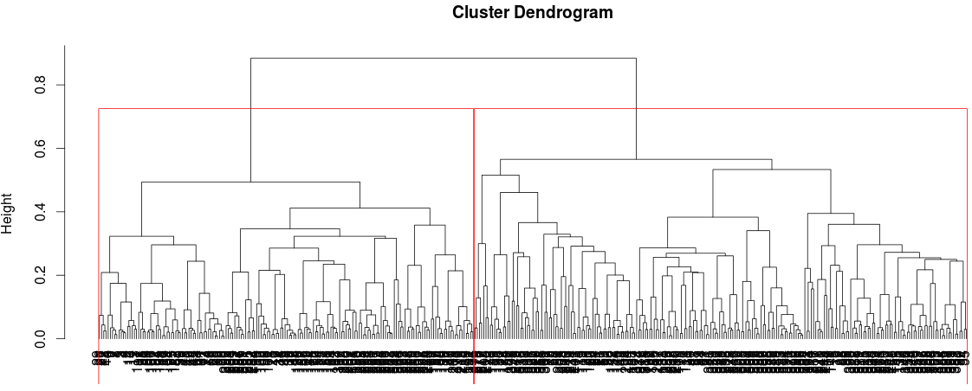
Hierarchical clustering with gower dist
Two cluster solution looks more appropriate in this dendogram

Slide 35
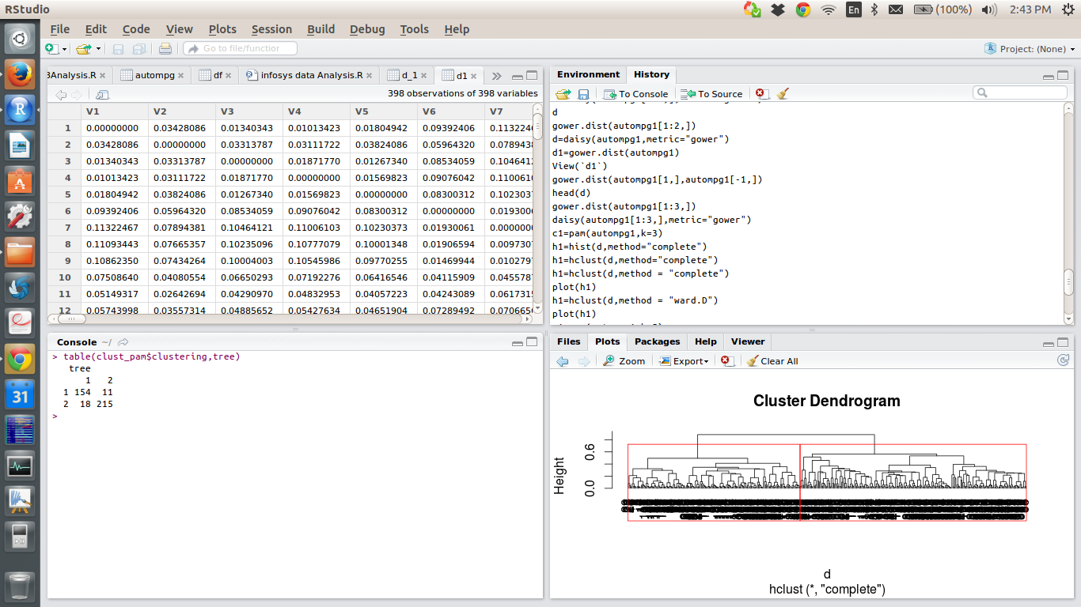
Hierarchical clustering with gower dist
Cross check with k-medoid clustering
We can see that there is considerable amount of agreement between k-medoid clustering and hierarchical clustering with gower distance
# K-medoid clustering with number of clusters as 2
clust_pam=pam(autompg1,k=2)
# Creating contingency table
table(clust_pam$clustering,tree)

